Slide 1
5. 컨트롤

Slide 2
JavaFX Controls
Button
Button, CheckBox, RadioButton, ToggleButton
Input
Label, TextField, TextArea, PasswordField, ComboBox, DatePicker, ColorPicker, HTMLEditor
View
ListView, TableView, ImageView
Media
Slider, ProgressBar, ProgressIndicator
Chart
PieChart, LineChart, AreaChart, BarChart, BubbleChart, ScatterChart

Slide 3
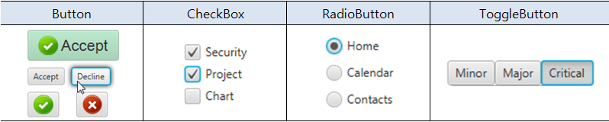
JavaFX Button Controls
버튼 컨트롤
마우스로 클릭 가능한 컨트롤. ButtonBase 상속하는 하위 컨트롤
버튼 컨트롤의 종류

Slide 4
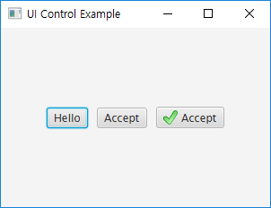
Button
생성
Button btn1 = new Button();
btn1.setText("Hello");
Button btn2 = new Button("Accept");
Image imgOK = new Image(this.getClass()
.getResourceAsStream("Check_16x16.png"));
Button btn3 = new Button("Accept", new ImageView(imgOK));

Slide 5
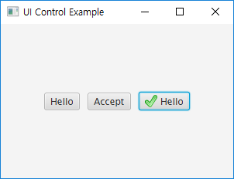
이벤트 처리
Button btn1 = new Button();
btn1.setText("Hello");
// Toggle
btn1.setOnAction(event -> {
if(btn1.getText().equals("Hello"))
btn1.setText("Accept");
else
btn1.setText("Hello");
});
Image imgOK = new Image(this.getClass().getResourceAsStream("Check_16x16.png"));
Button btn3 = new Button("Accept", new ImageView(imgOK));
// Toggle
btn3.setOnAction(new EventHandler<ActionEvent>() {
@Override
public void handle(ActionEvent e)
{
if(btn3.getText().equals("Hello"))
btn3.setText("Accept");
else
btn3.setText("Hello");
}
});

Slide 6
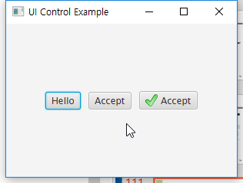
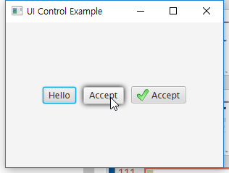
효과 추가
Button btn2 = new Button("Accept");
DropShadow shadow = new DropShadow();
// Adding the shadow
btn2.addEventHandler(MouseEvent.MOUSE_ENTERED,
event -> btn2.setEffect(shadow));
// Removing the shadow
btn2.addEventHandler(MouseEvent.MOUSE_EXITED,
event -> btn2.setEffect(null));
HBox.setMargin(btn2, new Insets(10));

Slide 7
Image를 가진 Button 만들기
setGraphic() 메소드
ImageView를 매개로 사용
FXML
<Button text="Button">
<graphic>
<ImageView>
<image>
<Image url=“@images/graphhs.png" />
</image>
</ImageView>
</graphic>
</Button>

Slide 8
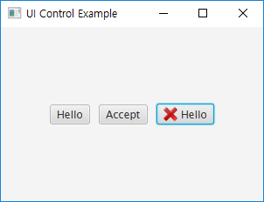
setGraphic()
Image imgOK = new Image(this.getClass()
.getResourceAsStream("Check_16x16.png"));
Image imgDel = new Image(this.getClass()
.getResourceAsStream("Delete_16x16.png"));
Button btn3 = new Button("Accept", new ImageView(imgOK));
// Toggle
btn3.setOnAction(new EventHandler<ActionEvent>() {
@Override
public void handle(ActionEvent e)
{
if(btn3.getText().equals("Hello"))
{
btn3.setText("Accept");
btn3.setGraphic(new ImageView(imgOK));
}
else
{
btn3.setText("Hello");
btn3.setGraphic(new ImageView(imgDel));
}
}
});

Slide 9
Button Example : 전체 코드
public void start(Stage primaryStage) throws Exception
{
HBox root = new HBox();
root.setAlignment(Pos.CENTER);
Button btn1 = new Button();
btn1.setText("Hello");
// Toggle
btn1.setOnAction(event -> {
if(btn1.getText().equals("Hello"))
btn1.setText("Accept");
else
btn1.setText("Hello");
});
Button btn2 = new Button("Accept");
DropShadow shadow = new DropShadow();
// Adding the shadow
btn2.addEventHandler(MouseEvent.MOUSE_ENTERED,
event -> btn2.setEffect(shadow));
// Removing the shadow
btn2.addEventHandler(MouseEvent.MOUSE_EXITED,
event -> btn2.setEffect(null));
HBox.setMargin(btn2, new Insets(10));

Slide 10
Image imgOK = new Image(this.getClass()
.getResourceAsStream("Check_16x16.png"));
Image imgDel = new Image(this.getClass()
.getResourceAsStream("Delete_16x16.png"));
Button btn3 = new Button("Accept", new ImageView(imgOK));
// Toggle
btn3.setOnAction(new EventHandler<ActionEvent>() {
@Override
public void handle(ActionEvent e)
{
if(btn3.getText().equals("Hello"))
{
btn3.setText("Accept");
btn3.setGraphic(new ImageView(imgOK));
}
else
{
btn3.setText("Hello");
btn3.setGraphic(new ImageView(imgDel));
}
}
});
root.getChildren().addAll(btn1, btn2, btn3);
Scene scene = new Scene(root,300,200);
primaryStage.setTitle("UI Control Example");
primaryStage.setScene(scene);
primaryStage.show();
}

Slide 11
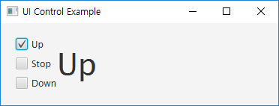
CheckBox
생성
String[] names = new String[] {"Up", "Stop", "Down"};
CheckBox[] cb = new CheckBox[names.length];
VBox left = new VBox();
left.setSpacing(10);
for(int i=0; i<names.length; i++)
{
CheckBox b = cb[i] = new CheckBox(names[i]);
left.getChildren().add(b);
}

Slide 12
이벤트 처리(속성감시)
for(int i=0; i<names.length; i++)
{
CheckBox b = cb[i] = new CheckBox(names[i]);
left.getChildren().add(b);
b.setUserData(names[i]);
b.selectedProperty().addListener(new ChangeListener<Boolean>() {
@Override
public void changed(
ObservableValue<? extends Boolean> observable,
Boolean oldValue, Boolean newValue)
{
....
}
});
}

Slide 13
public void start(Stage primaryStage) throws Exception
{
HBox root = new HBox();
root.setPadding(new Insets(20));
String[] names = new String[] {"Up", "Stop", "Down"};
CheckBox[] cb = new CheckBox[names.length];
Label[] labels = new Label[names.length];
VBox left = new VBox();
left.setSpacing(10);
HBox right = new HBox();
right.setSpacing(10);
right.setAlignment(Pos.CENTER);
root.getChildren().addAll(left, right);
for(int i=0; i<names.length; i++)
{
Label label = labels[i] = new Label(names[i]);
label.setFont(new Font(40));
CheckBox b = cb[i] = new CheckBox(names[i]);
if(i == 0) b.setSelected(true);
left.getChildren().add(b);
전체코드

Slide 14
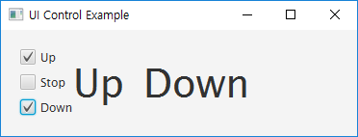
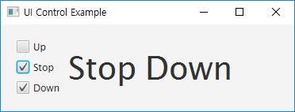
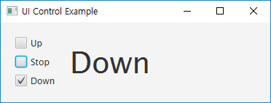
b.setUserData(names[i]);
b.selectedProperty().addListener(new ChangeListener<Boolean>() {
@Override
public void changed(ObservableValue<? extends Boolean>
observable, Boolean oldValue, Boolean newValue)
{
if(newValue == true)
label.setText(b.getUserData().toString());
else
label.setText(null);
}
});
right.getChildren().add(label);
if(i != 0) label.setText(null);
}
Scene scene = new Scene(root,370,110);
primaryStage.setTitle("UI Control Example");
primaryStage.setScene(scene);
primaryStage.show();
}

Slide 15
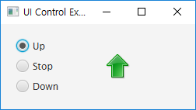
RadioButton
생성
ToggleGroup group = new ToggleGroup();
RadioButton b1 = new RadioButton();
b1.setText("Up");
RadioButton b2 = new RadioButton("Stop");
RadioButton b3 = new RadioButton("Down");
b1.setToggleGroup(group);
b1.setSelected(true);
b2.setToggleGroup(group);
b3.setToggleGroup(group);
Image up = new Image(this.getClass().getResourceAsStream("Up.png"));
ImageView icon = new ImageView(up);
VBox left = new VBox();
left.setSpacing(10);
left.getChildren().addAll(b1, b2, b3);
HBox right = new HBox();
right.setPrefWidth(150);
right.setAlignment(Pos.CENTER);
right.getChildren().add(icon);
root.getChildren().addAll(left, right);

Slide 16
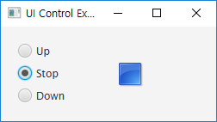
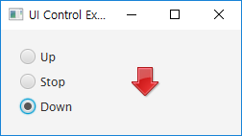
이벤트 처리(속성감시)
setUserData() / getUserData()
getSelectedToggle()
b1.setUserData("Up.png");
b2.setUserData("Stop.png");
b3.setUserData("Down.png");
group.selectedToggleProperty().addListener(new ChangeListener<Toggle>() {
@Override
public void changed(ObservableValue<? extends Toggle> observable,
Toggle oldValue, Toggle newValue)
{
if(group.getSelectedToggle() != null)
{
Image img = new Image(this.getClass().getResourceAsStream(
group.getSelectedToggle().getUserData().toString()
));
icon.setImage(img);
}
}
});

Slide 17
전체코드
public void start(Stage primaryStage) throws Exception
{
HBox root = new HBox();
root.setPadding(new Insets(20));
ToggleGroup group = new ToggleGroup();
RadioButton b1 = new RadioButton();
b1.setText("Up");
RadioButton b2 = new RadioButton("Stop");
RadioButton b3 = new RadioButton("Down");
b1.setToggleGroup(group);
b1.setSelected(true);
b2.setToggleGroup(group);
b3.setToggleGroup(group);
Image up = new Image(this.getClass().getResourceAsStream("Up.png"));
ImageView icon = new ImageView(up);
b1.setUserData("Up.png");
b2.setUserData("Stop.png");
b3.setUserData("Down.png");
group.selectedToggleProperty().addListener(new ChangeListener<Toggle>() {
@Override
public void changed(ObservableValue<? extends Toggle> observable,
Toggle oldValue, Toggle newValue)
{

Slide 18
if(group.getSelectedToggle() != null)
{
Image img = new Image(this.getClass().getResourceAsStream(
group.getSelectedToggle().getUserData().toString()
));
icon.setImage(img);
}
}
});
VBox left = new VBox();
left.setSpacing(10);
left.getChildren().addAll(b1, b2, b3);
HBox right = new HBox();
right.setPrefWidth(150);
right.setAlignment(Pos.CENTER);
right.getChildren().add(icon);
root.getChildren().addAll(left, right);
Scene scene = new Scene(root,250,110);
primaryStage.setTitle("UI Control Example");
primaryStage.setScene(scene);
primaryStage.show();
}

Slide 19
선택상태 설정
CheckBox, RadioButton, ToggleButton
selected 속성 지정
그룹지정
RadioButton, ToggleButton
(예)
<RadioButton text="RadioButton1" selected="true">
<toggleGroup>
<ToggleGroup fx:id="group1" />
</toggleGroup>
</RadioButton>
<RadioButton text="RadioButton2" toggleGroup="$group1" />

Slide 20
이벤트 처리
CheckBox, RadioButton, ToggleButton
ActionEvent 발생
EventHandler 또는 FXML 컨트롤러를 구현
그룹 내 속성감시
@FXML private ToggleGroup groupName;
groupName.selectedToggleProperty().addListener(new ChangeListener<Toggle>() {
@Override
public void changed(ObservableValue<? extends Toggle> obserable,
Toggle oldValue, Toggle newValue)
{
// TODO Auto-generated method stub
}
});

